Slide 1
Testing

Slide 2

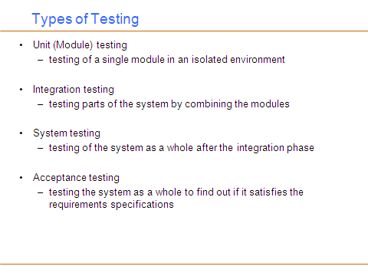

Slide 3
Unit Testing
Involves testing a single isolated module
Note that unit testing allows us to isolate the errors to a single module
  we know that if we find an error during unit testing it is in the module we are testing
Modules in a program are not isolated, they interact with each other. Possible interactions:
  calling procedures in other modules
  receiving procedure calls from other modules
  sharing variables
For unit testing we need to isolate the module we want to test, we do this using two things
  drivers and stubs

Slide 4
Drivers and Stubs
Driver: A program that calls the interface procedures of the module being tested and reports the results
  A driver simulates a module that calls the module currently being tested
Stub: A program that has the same interface as a module that is being used by the module being tested, but is simpler.
  A stub simulates a module called by the module currently being tested

Slide 5
Drivers and Stubs
Driver
Module
Under Test
Stub
procedure
call
procedure
call
access to global
variables
Driver and Stub should have the same interface as the modules they replace
Driver and Stub should be simpler than the modules they replace

Slide 6
Integration Testing
Integration testing: Integrated collection of modules tested as a group or partial system
Integration plan specifies the order in which to combine modules into partial systems
Different approaches to integration testing
  Bottom-up
  Top-down
  Big-bang
  Sandwich

Slide 7
Module Structure
A
B
We assume that
the uses hierarchy is
a directed acyclic graph.
If there are cycles merge
them to a single module
D
level 1
C
H
level 0
E
F
G
I
A uses C and D; B uses D; C uses E and F; D uses F, G, H and I; H uses I
Modules A and B are at level 3; Module D is at level 2
Modules C and H are at level 1; Modules E, F, G, I are at level 0
level 0 components do not use any other components
level i components use at least one component on level i-1 and no
component at a level higher than i-1

Slide 8
Bottom-Up Integration
Only terminal modules (i.e., the modules that do not call other modules) are tested in isolation
Modules at lower levels are tested using the previously tested higher level modules
Non-terminal modules are not tested in isolation
Requires a module driver for each module to feed the test case input to the interface of the module being tested
  However, stubs are not needed since we are starting with the terminal modules and use already tested modules when testing modules in the lower levels

Slide 9
Bottom-up Integration
A
B
D
C
H
E
F
G
I

Slide 10
Top-down Integration
Only modules tested in isolation are the modules which are at the highest level
After a module is tested, the modules directly called by that module are merged with the already tested module and the combination is tested
Requires stub modules to simulate the functions of the missing modules that may be called
  However, drivers are not needed since we are starting with the modules which is not used by any other module and use already tested modules when testing modules in the higher levels

Slide 11
Top-down Integration
A
B
D
C
H
E
F
G
I

Slide 12
Other Approaches to Integration
Sandwich Integration
  Compromise between bottom-up and top-down testing
  Simultaneously begin bottom-up and top-down testing and meet at a predetermined point in the middle
Big Bang Integration
  Every module is unit tested in isolation
  After all of the modules are tested they are all integrated together at once and tested
  No driver or stub is needed
  However, in this approach, it may be hard to isolate the bugs!

Slide 13
System Testing, Acceptance Testing
System and Acceptance testing follows the integration phase
  testing the system as a whole
Test cases can be constructed based on the the requirements specifications
  main purpose is to assure that the system meets its requirements
Manual testing
  Somebody uses the software on a bunch of scenarios and records the results
  Use cases and use case scenarios in the requirements specification would be very helpful here
  manual testing is sometimes unavoidable: usability testing

Slide 14
System Testing, Acceptance Testing
Alpha testing is performed within the development organization
Beta testing is performed by a select group of friendly customers
Stress testing
  push system to extreme situations and see if it fails
  large number of data, high input rate, low input rate, etc.

Slide 15
Regression testing
You should preserve all the test cases for a program
During the maintenance phase, when a change is made to the program, the test cases that have been saved are used to do regression testing
  figuring out if a change made to the program introduced any faults
Regression testing is crucial during maintenance
  It is a good idea to automate regression testing so that all test cases are run after each modification to the software
When you find a bug in your program you should write a test case that exhibits the bug
  Then using regression testing you can make sure that the old bugs do not reappear

Slide 16
Thanks

